Slide 1
ERASE DATA REMOTELY
SECONDARY (Black Hat)
EDR Reloaded: Erase Data Remotely
Presented By
NIRAJ

Slide 2
ERASE DATA REMOTELY
Points to be discussed
What is EDR
Why it is important in healthcare organizations and its significance in the health sector?
What are the consequences if EDR is not processed successfully?
Why do vulnerable data need EDR if compromised?
What kind of Security and Privacy are needed during the EDR process?
How the EDR can resolve the problem, what are the challenges during overcoming the issues, and their feasible solution?

Slide 3
introduction
WHAT IS EDR
Remote data erasure is the process of deleting data remotely from devices to prevent unauthorized access.
it is a burdensome task for defenders and the hotspot zone in case of devices are lost /stolen /compromised

Slide 4
TO BE CONTINUED…
Healthcare data of patients are very crucial to healthcare organizations because of the safety requirements of patients and regulatory compliance.
Erase Data Remotely is important when the sensitive information is compromised /leaked if devices become lost or stolen or reach the offenders. If the patient data is compromised resultantly it may ruin their professional and personal lives of patients as well reputation of the health care organization.

Slide 5
Serious Consequences in the Health Care Organisation
In the modern world, the data has been stored in the cloud/Google Drive/OneDrive because it is easy to handle, cost-effective, interoperability, and easier and faster policy. However, in many hospital settings, it is stored in small devices like laptops, and portable devices and not well protected because of poor security or the unawareness of staff, resulting in is very high probability of leaking data when it is lost. And offenders start blackmailing the patients as well as healthcare organizations.

Slide 6
To be continued ..
Data Related to Patients ‘Health –loss of critical files or patient data not only delays the treatment but may also raise life-threatening situations.
Legal and Financial repercussions/regulatory penalties- Healthcare organizations may face lawsuits because of negligence, violating the HIPPA rule, huge penalties, and loss of reputation due to compromised patient data. And permanently banned their license.

Slide 7
Why do vulnerable data need EDR if compromised?
The government and the commanding authorities spending millions of dollars to build a robust health system. However, if the data is compromised, it will cost billions of dollars to regain it. Also, Breaching confidential information faces legal and serious consequences for health organizations because the professional and personal life of the patient and the reputation of the organization may be ruined.

Slide 8
Security and privacy concerns during edr process
SECURITY-
Unauthorized access- Offenders may gain an advantage to access the healthcare system and remotely erase data which permanently loss the patient information
Malware and Ransomware –malicious software can be used to encrypt or delete the data, demanding a huge money for its return
Devices vulnerabilities- unsecured devices can be targeted and erase data remotely may permanently crash the file from all systems

Slide 9
TO BE CONTINUED ..
PRIVACY
Patient confidentiality –remote data erasers can expose sensitive health information.
Regulatory compliance –Health organizations must comply with data protection laws HIPAA and remote data erasers may lead to violations.
System Downtime- remote data erasure can slow the system during the process, affecting health services and disruption.

Slide 10
Challenges
Disrupt the operation- It is also a high risk during remote erasure to disrupt the operation, accuracy, and completeness of medical records. And may permanently lose the data if there is no backup.
It may violate regulatory compliance – during the process the adherence to the protection of data laws like HIPPA is very hard to maintain
Data fragmentation- Managing multiple devices in a broad healthcare network to ensure all endpoints are safe and secure because many times it shows false positive results.

Slide 11

THANKFUL GETTYIMAGES, CREDITED MTSTOCK STUDIO.

Slide 12
To be continued..
Remote deletion vulnerabilities are hard to fix especially when security control byte signature selection. The byte signature engine in software is very well protected by multilayer and trusted and very hard to trigger.
Security patches might be incomplete and another security layer may be activated due to a single point of failure. As well as it often leads to the introduction of bypasses and unexpected errors.

Slide 13
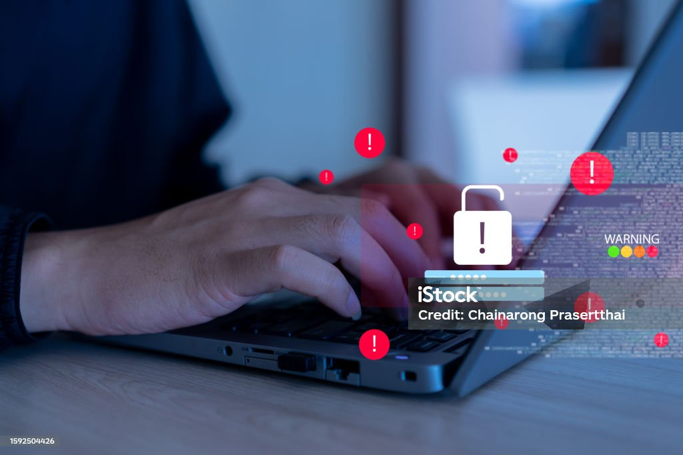
PHOTO TAKEN FROM iStock credit:chainarong prasertthal

Slide 14
Feasible solution to mitigate the issues
Multifactor security system – implementing the strong authentication method to ensure that only authorized individuals or organizations can initiate data erasure remotely
Deploying Endpoint detection- it is also of utmost need to monitor malicious activities in real-time.
Regular backup- to maintain frequent and secure backups of all critical data to allow recovery in suspicious or malicious data erasure
Training of health staff- Protecting the data is the primary goal in the electronic setting. To organize regular training to educate staff on security best practices and the importance of safeguarding devices.

Slide 15
Conclusion
Devices must be fully secured
Healthcare professional must be trained on how to protect their device and data
Multifactor security is needed so that unauthorized persons can not get an advantage.
Data must be deleted with a simple process if the device is stolen or lost.

Slide 16
THANK YOU

